Slide 1







Koni Forsa Campaign
Presented by:
Maya 235127
Areej 228965
Hanin 230756

Slide 2

Table of contents
01 Introduction
02 Marketing mix
03 Swot analysis
05 Competitive Analysis
04 PESTEL Analysis
06 Target Audience
07 Creative Strategy
08 Advertising platforms
09 Timeline
12 Evaluation& Measurement
10 Budget
11 Media planning

Slide 3











01
Introduction

Slide 4



Introduction
  The campaign targets C-class women between ages 22 and 45.
  Raising the awareness toward financial independence and the importance of work and the challenges they face
  the campaign helping women to overcome the challenges
  The campaign is 3 months, starting in March and ending in May.

Slide 5
02
Marketing Mix

Slide 6





Marketing Mix
Product
Place
Price
  Digital media
  Traditional media
  Provide workshops, seminars, videos.
  women cost are only the effort and time in participation
  Raise awareness about struggles that women face when they need to be financially independent.
  the campaign will motivate women by providing successful example stories like Mona el khodeiry

Slide 7




Marketing Mix
Promotion
People
Process
Physical
Evidence
  Influencers (Walaa Abdelrahman, Ahlam Adel).
  Life coaches (Dalia Zaky, Rana Elkhayat).
  Lawyer (Nehad Abo elkomsan).
  Story techniques used to provoke emotions.
  PR coverage of the issue
  Media campaign coverage of events
  Start with raising awareness.
  End with change behavior
  Consistency in branding content

Slide 8
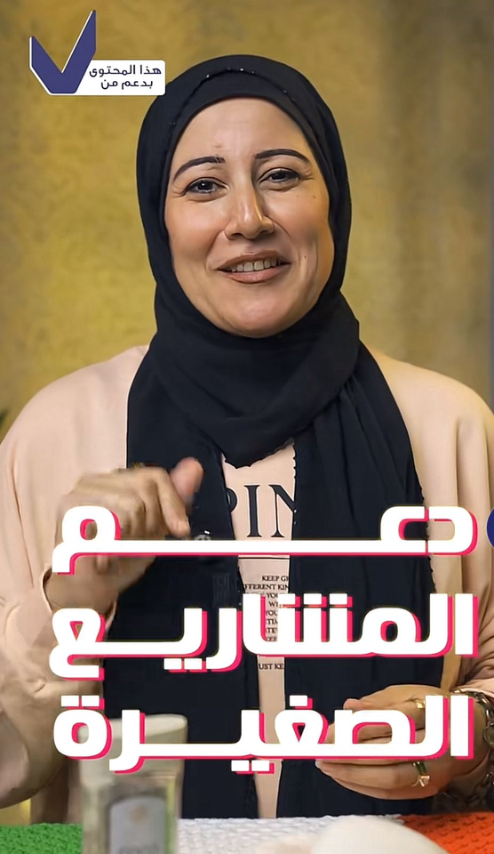
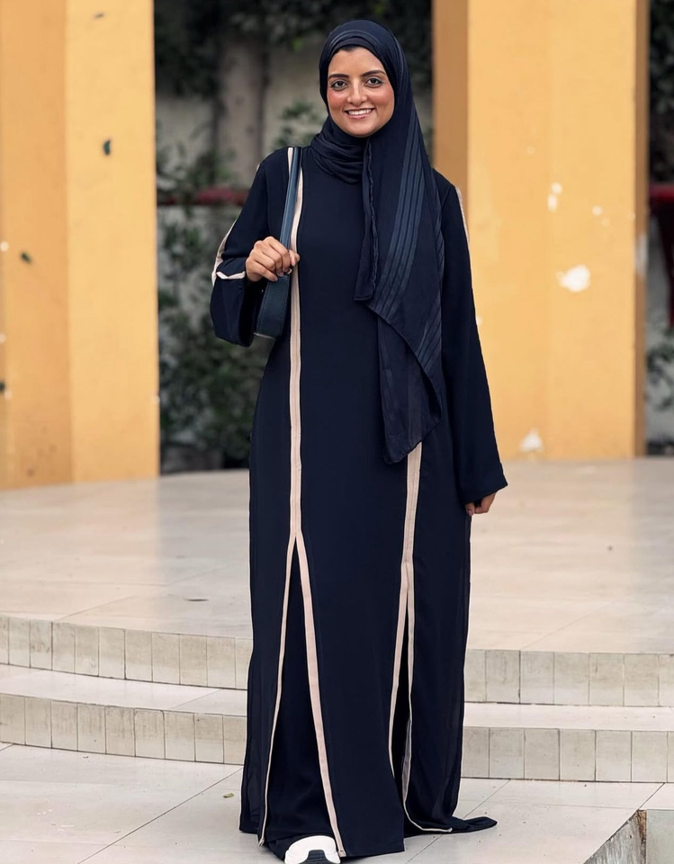
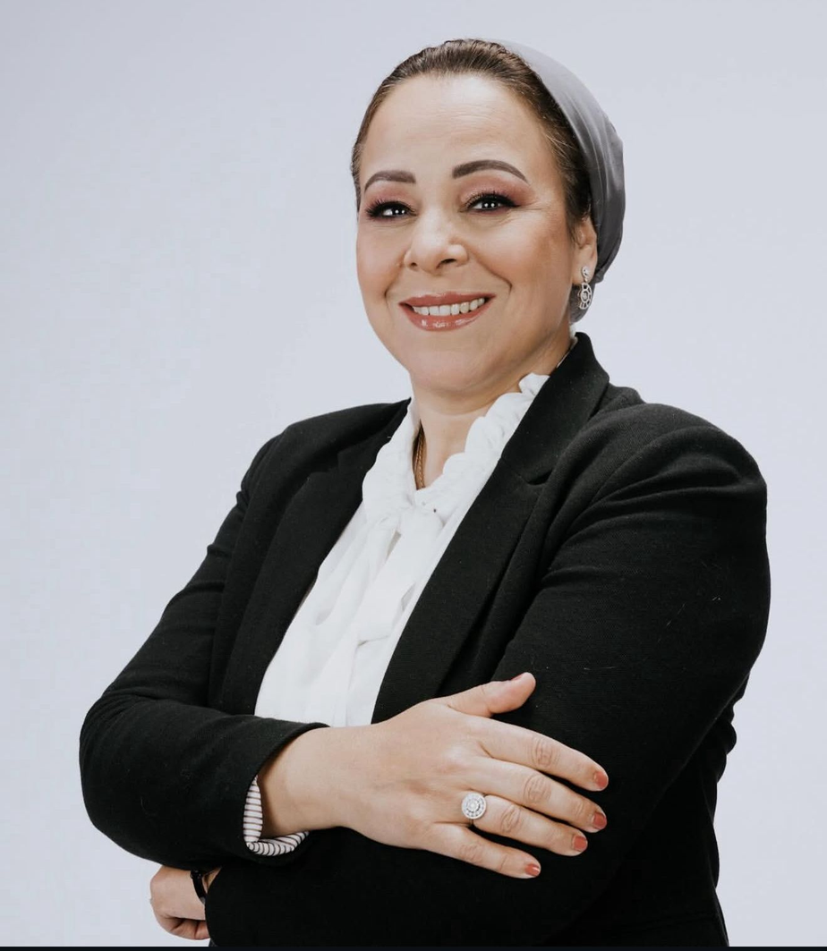

Slide 9




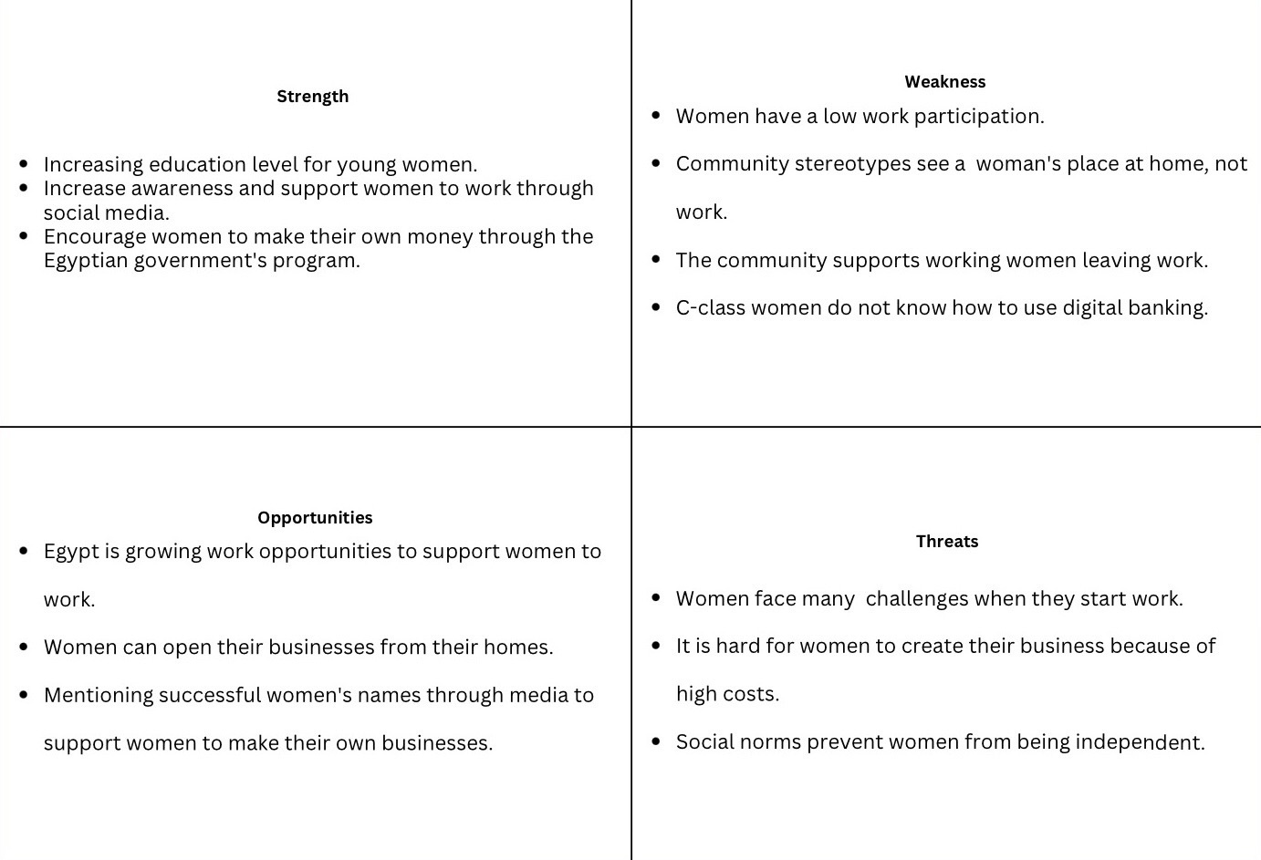
Swot Analysis

Slide 10
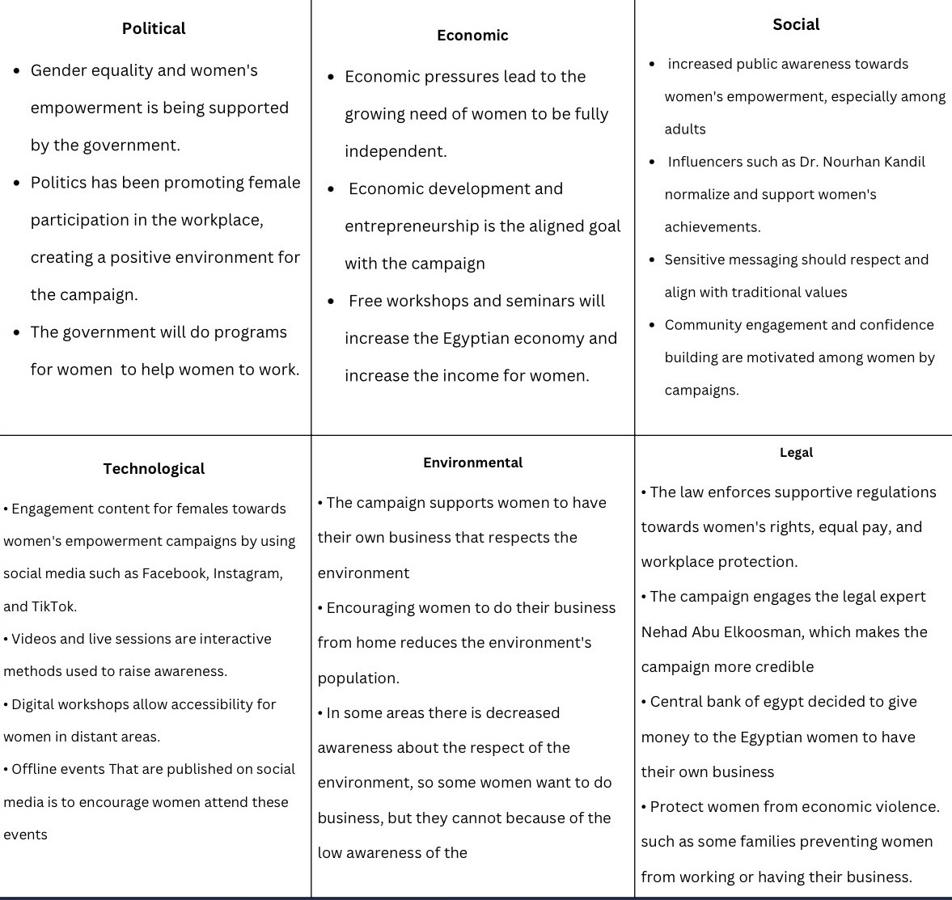
PESTEL analysis

Slide 11
PESTEL analysis

Slide 12
Competitive analysis
05

Slide 13


Competitive Analysis
1-Rabeha Initiative
  Launched in 2022
  The UN Women collaboration with UNIDO, and MSMEDA.
  Target Women in 7 governorates (Cairo, Alexandria, Giza, Behira, Fayoum, Beni Suef, and Minya.
  Offering job opportunities to more than 6,300 women.
  “Rabeha” provides workshops about financial independence.

Slide 14
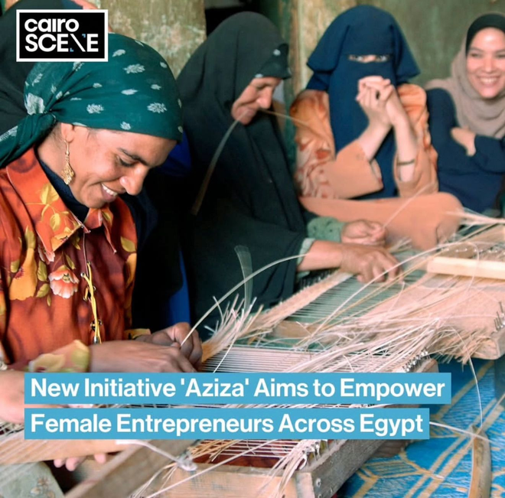
Competitive Analysis
2-Aziza Initiative
  Launched in 2024, on Mother’s Day by MSMEDA.
  Targets women who have difficulty in starting her business.
  Offers loans to support women economically
  provide marketing support and training

Slide 15

Competitive Analysis
3- She Leads
  Launched in October 2025
  Targets university females aged 18- 25.
  It appeals Cairo and Alexandria
  Provides workshops to enhance female’s skills

Slide 16
06
Target Audience

Slide 17

Target Audience
Demographic
  According to CAPMAS (2025), In Egypt, Women form approximately 23.4% of Egypt’s workforce.
  While the rate of women unemployment women 15.8% of different ages.
  Target married or single women in Egypt. Aged between 22-45
  C class with low-income level
  Higher education and institutions.

Slide 18
Target Audience
Psychographic
  Seek equality, independence, and self -growth.
  Strong desire to improve themselves financially
  want to maintain stability and build a better future for themselves and their families.
  They have a great belief in their abilities.
  They are against being tied with social norms and traditions.

Slide 19
Target Audience
Behavioral
  Active on social media platforms
  They searched for workshops.
  Followed influencers who inspired them to find stable job opportunities
  Balance their personal family life and work life.
  They have a great belief in themselves and seek improvement and independence.

Slide 20
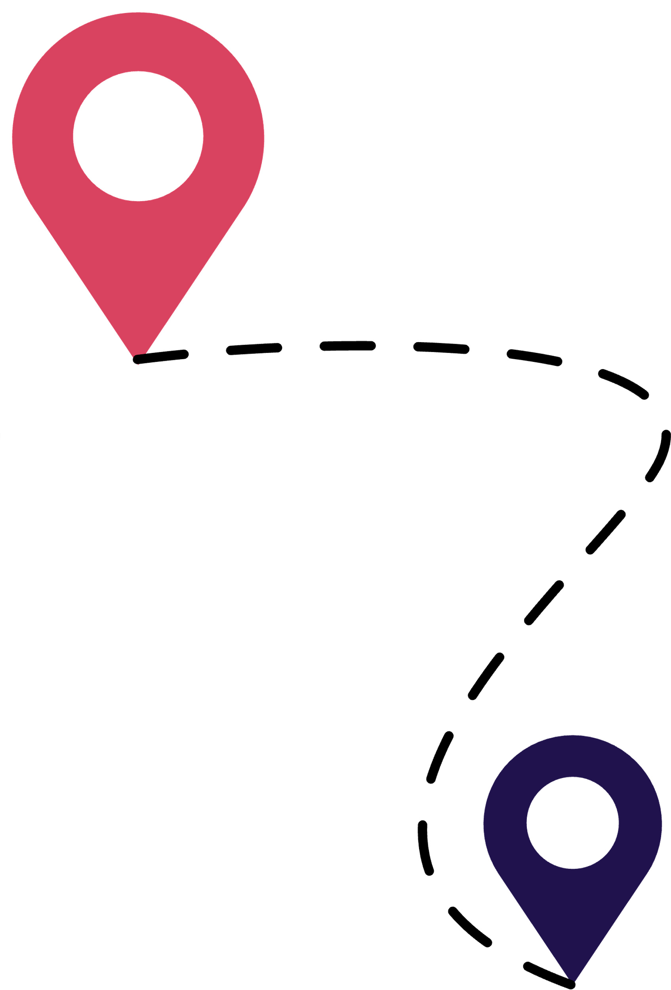
Target Audience
Geographic
  Campaign targets women who live in: Cairo, Giza, and Alexandria.
  Percentage of unemployment in urban areas is 9.7% of the total workforce, compared to 3.3% in rural areas (CAMPAS, 2025).

Slide 21
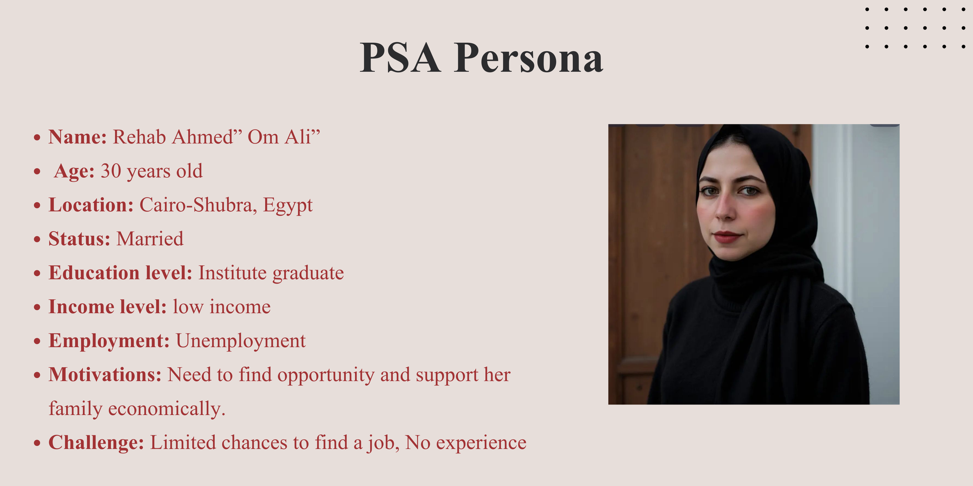

Slide 22
Strategic Plan: (KPIs)

Slide 23
The campaign aims to empower Egyptian women aged 22-45 in the C-class segment by educating them how to overcome challenges and economic independence

Slide 24
  Pre-Production: Define objectives. Identify the target audience, prepare scripts and storyboards, and create a timeline.
  production: filming advertisement videos, recording audios, designing visuals and graphics, and collaborating with influencers to create a buzz for the campaign
  post-production editing the advertisement videos and audio, adding subtitles, reviewing the content to see that it aligns with the campaign, distributing the content through social platforms and traditional media, and tracking the engagement and feedback

Slide 25
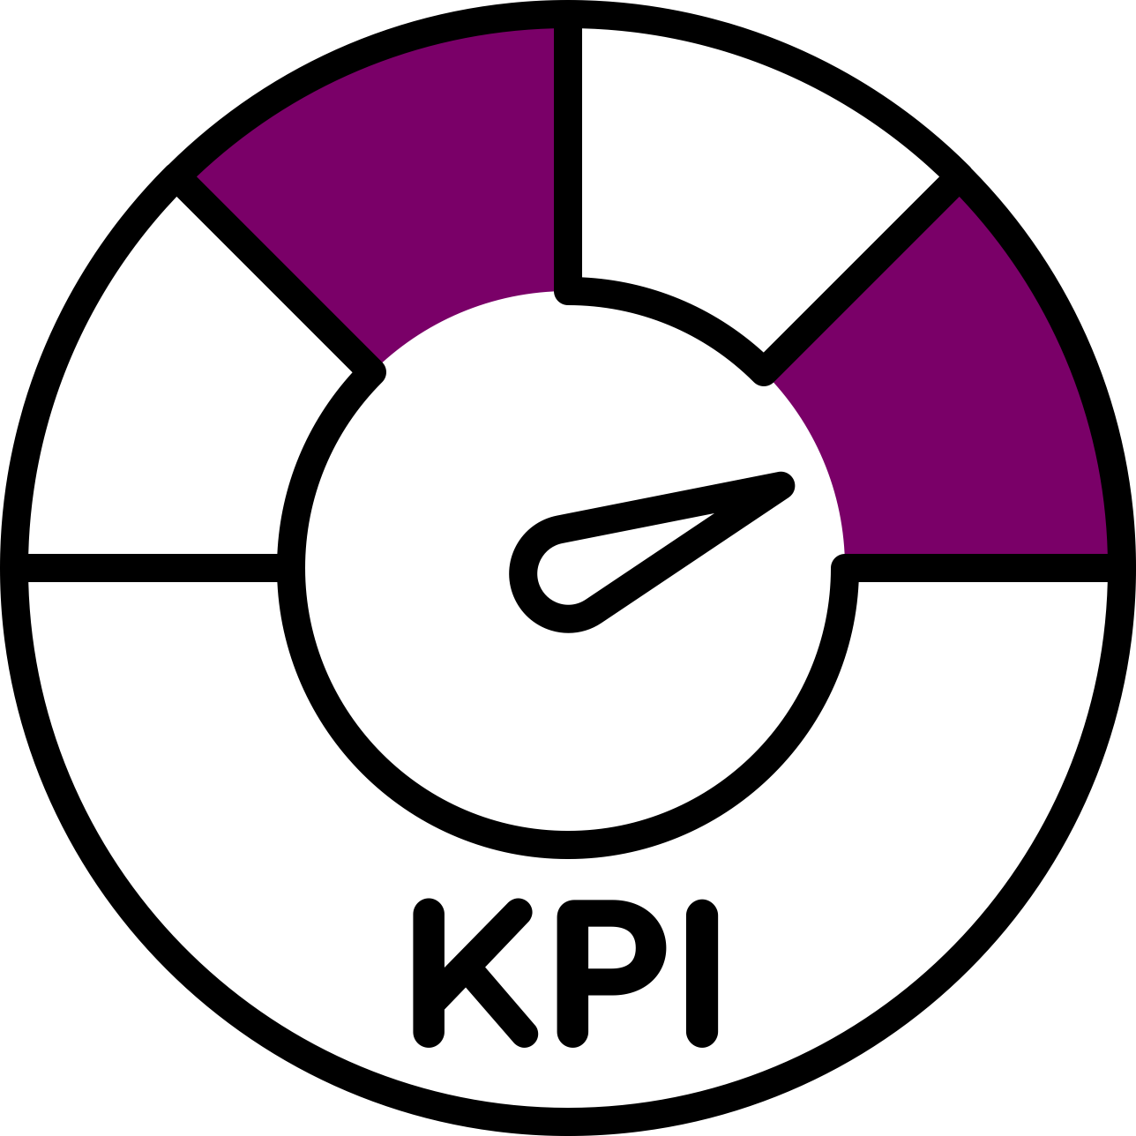
KPIS
  The campaign reaches over 550,000 women
  over 45,000 interactions campaign with social media platforms
  15,000 visits to the campaign social platform.

Slide 26

07
Creative Strategy

Slide 27
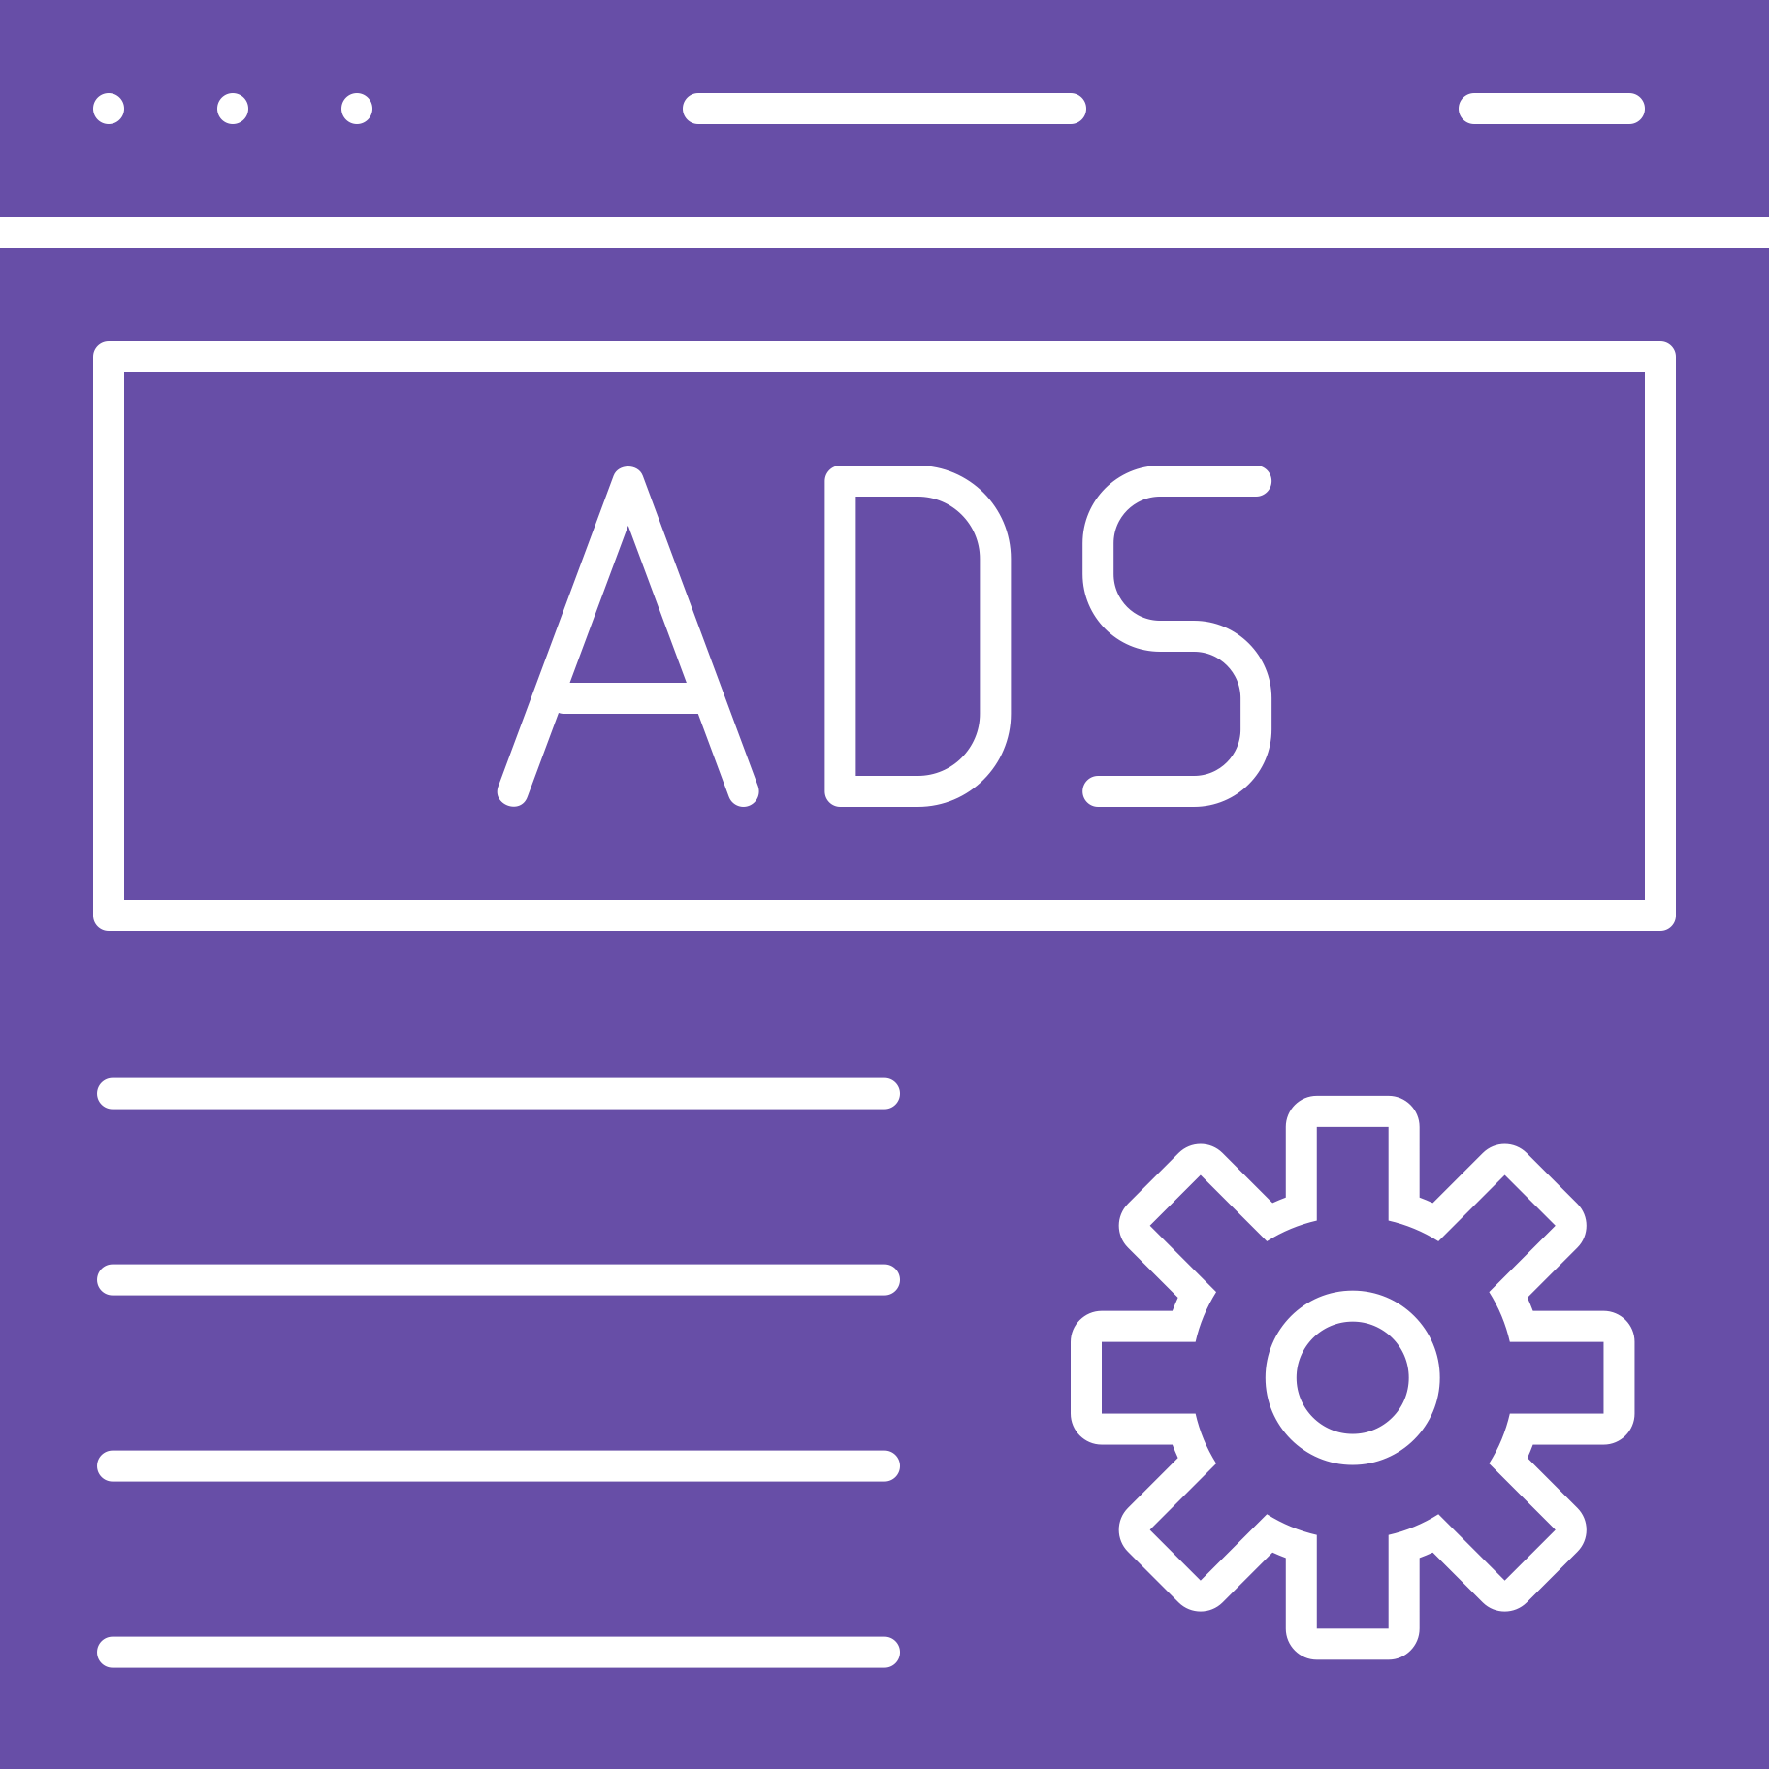
Appeals & Execution Styles
Appeals
  Emotional Appeal (Empathy Appeal)
Execution Styles
  Storytelling
  Slice of life

Slide 28
BUI
C-class women need practical tips to start their financial independence.
Slogans
فرصتك سر قوتك
Endlines
خطوة صغيرة تحقق حلم كبير

Slide 29


Audio Visual
Audio | Visual
تعليق صوتي: دول شادية ونادية الاتنين مختلفين عن بعض تماما برغم انهم من نفس الطبقة الاجتماعية | شاشة منقسمة نصفين تظهر امرأتين من فئة بسيطة لكن لديهم عائلات مختلفة الفكر.
تأثيرات صوتية: صوت طاسة وزيت | شادية ونادية بيحضروا الفطار لعائلاتهم
تعليق صوتي: الاثنين قالوا لعائلاتهم ان كانوا بيدوروا على شغل عندهم مقابلة كمان شوية بس رد الفعل كان مختلف | شاشة منقسمة نصفين لشادية و نادية
احمد جوز نادية: شغل ايه الي عايزه تشتغلي ركزي مع بيتك و عيالك احسن | احمد: بيتكلم بطريقة فيها سخرية مع نادية نادية: ظهور ملامح محبطة على الوجه

Slide 30
Audio Visual
Audio | Visual
حسن جوز شادية: كويسة الفكرة ربنا يوفقك | حسن: بيتكلم بطريقة فيها حماس مع شادية شادية: ملامح الفرح على الوجه
المحاور: تقدري توفقي بين شغلك وبيتك | نادية: ملامح الإحباط على وجهها و مرضتش
المحاور: شكرا يا نادية شادية: طبعا انا عائلتي تدعمني و واخده كذا ورشة زي الثقافة المالية المحاور: مبروك يا شادية تقدر تستلمي الشغل | شادية: ملامح فرح و حماس

Slide 31
Audio Visual
Audio | Visual
 | شادية: في الشغل و مبسوطة و معاها نوت بوك بتكتب فيها ورا المدير بيقولوا نادية: في البيت بتراعي اولادها و بتعمل شغل البيت وباين على ملامحها الإرهاق و الإحباط
تعليق صوتي: شادية اترقت و بتفكر تفتح مشروعها الخاص و نادية لسه زي ما هي فايدك القرار يتكوني نادية او شادية

Slide 32
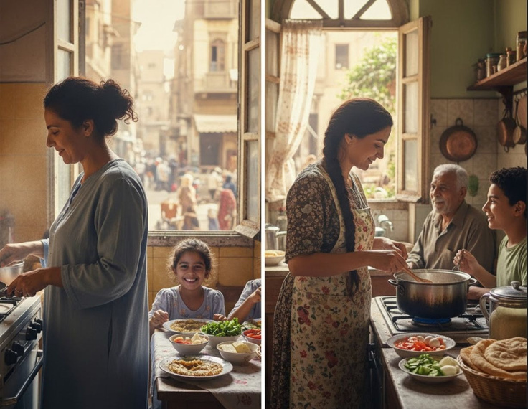
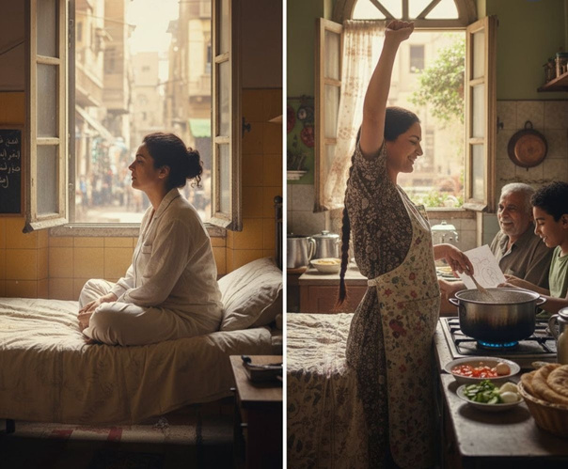
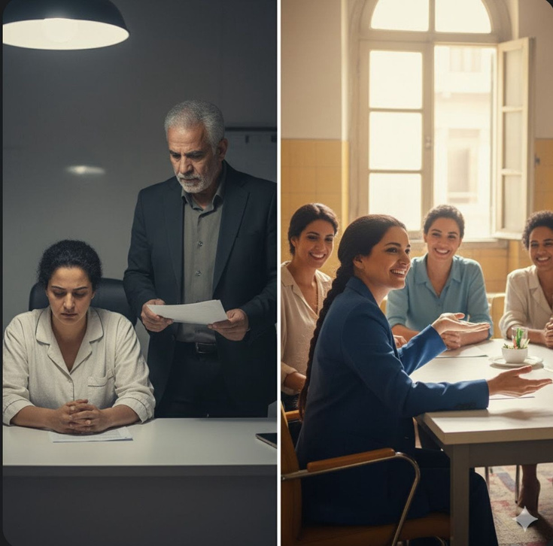
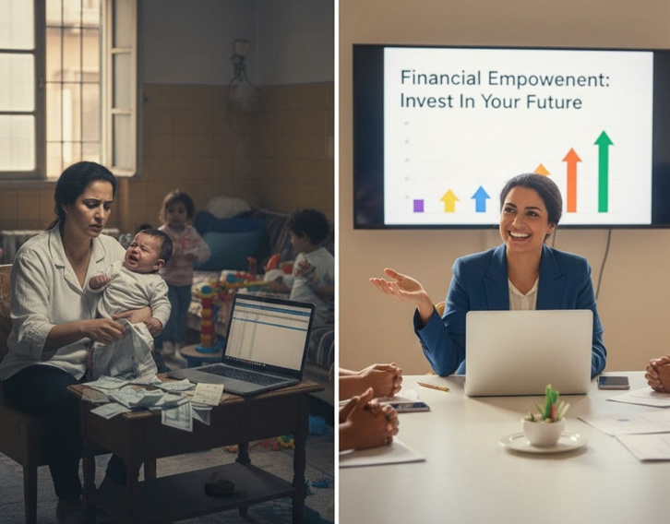
Storyboard

Slide 33

Radio Channel
Audio | Visual
ساره: انا ساره عندي 23 سنه (بصوت هادي)
سارة: طول عمري الناس بتقولي الست مكانها المطبخ و مش مفروض تشتغل
سارة: و اتربيت على فكرة أن مشتغلش و مع وقت صدقت ده
سارة: في يوم قلت لنفسي لو انا مكاني المطبخ ليه مستغلش ده و ابدأ من هنا

Slide 34
Radio Channel
Audio | Visual
 | موسيقى هادئة
ساره: بدأت بمشروع بيع أكل بيتي
ساره: و نزلت صور اكلي على الانستجرام و الناس بدأت تطلب مني و صفحتي اتعرفت و بدات اكبر في مجالي
ساره : و دلوقتي اقدر اقول ان حققت حلمي بعد ما فتحت مطعمي

Slide 35
Radio Channel
Audio | Visual
 | موسيقى هادئة
ساره: بدأت بمشروع بيع أكل بيتي
ساره: و نزلت صور اكلي على الانستجرام و الناس بدأت تطلب مني و صفحتي اتعرفت و بدات اكبر في مجالي
ساره : و دلوقتي اقدر اقول ان حققت حلمي بعد ما فتحت مطعمي | تائثيرات صوتي: صوت زبون, خطوات قدم في مكان زحمة, معلقة.

Slide 36
Radio Channel
Audio | Visual
تائثيرات صوتي: صوت زبون, خطوات قدم في مكان زحمة, معلقة.

Slide 37
10
Timeline

Slide 38
Client Brief: Minister of Social Solidarity
Deadline: 1st March
Market Research and Audience Insights
Deadline: 3rd March
Focus group discussion with audience
Deadline: 5th March
First Draft of Creative Designs
Deadline: 12th March
Video Script, Storyboard, and Radio ad
Deadline: 15th March
First edit of Campaign Video
Deadline : 20th March
Ad Copy from Copywriting Team
Deadline : 24th March

Slide 39
Creative Drafts Sent to Client
Deadline : 27th March
Feedback on Creative Materials
Deadline: 1st April
Final Edits on Creative Materials
Deadline: 5th April
Traditional media ads launch
Deadline: 10th April
Social Media Ads Launch
Deadline : 10th April
OOH media ad launch
Deadline: 10th April
Mid-Campaign improvements
Deadline : 10th May
Campaign ends across all platforms.
Deadline: 25th May
Analyzing campaign results
Deadline: 27th May
The team shares findings of the campaign.
Deadline: 31st May

Slide 40
10
Budget

Slide 41

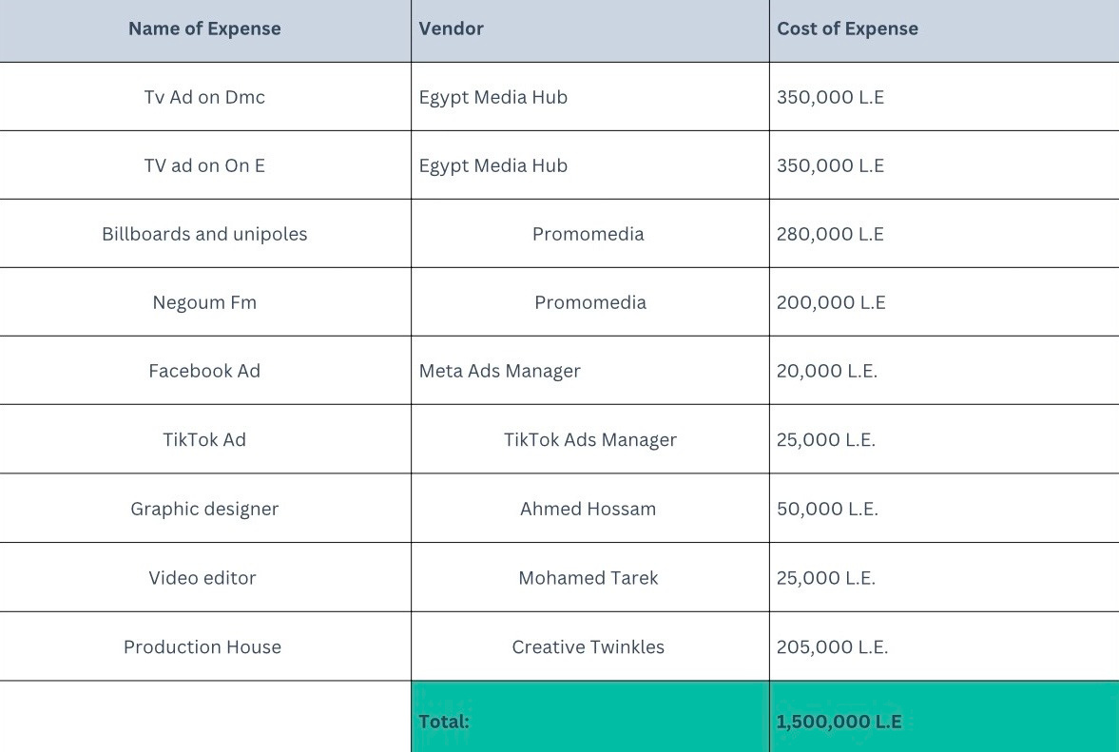


Slide 42
11
Media Planning

Slide 43
Media Planning
  Continuity pattern (Facebook, TikTok, Billboards)
  Pulsing pattern(TV, Radio, and unipols)

Slide 44
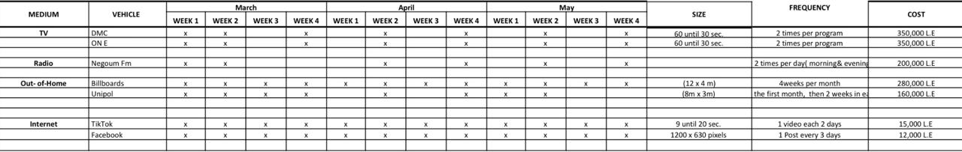
Media Planning
Flow Chart:

Slide 45
12
Evaluation
& measurement

Slide 46


1.Pre-testing methods
Focus group discussion:
  Asking deep questions about their attitudes, feelings and perceptions about the campaign concept.
  This data help to know their behavior in terms of what they avoid and what motivates them.
  help in design campaign names, slogans, and endline

Slide 47
2.Post-testing methods
Sales Analysis:
  Measure percentage of women who overcome struggles and become financially independent.
Digital Analytics:
  Measure engagement (AppsFlyer)
  Analyze comments (Meta and TikTok insights)

Slide 48

Campaign Logo

Slide 49
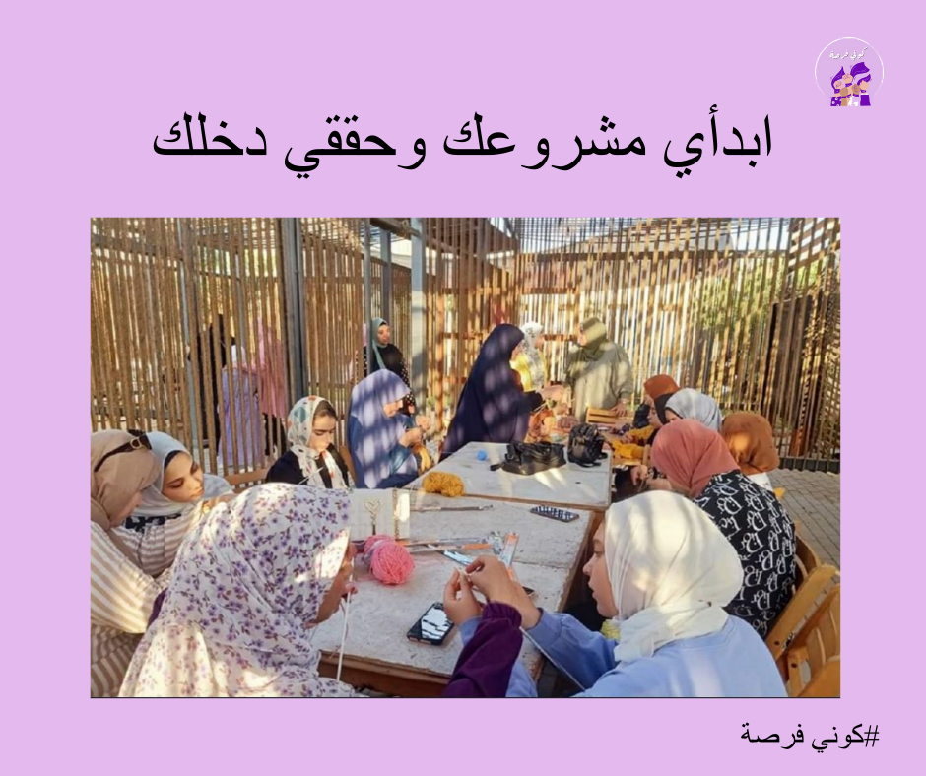

Social media posts

Slide 50
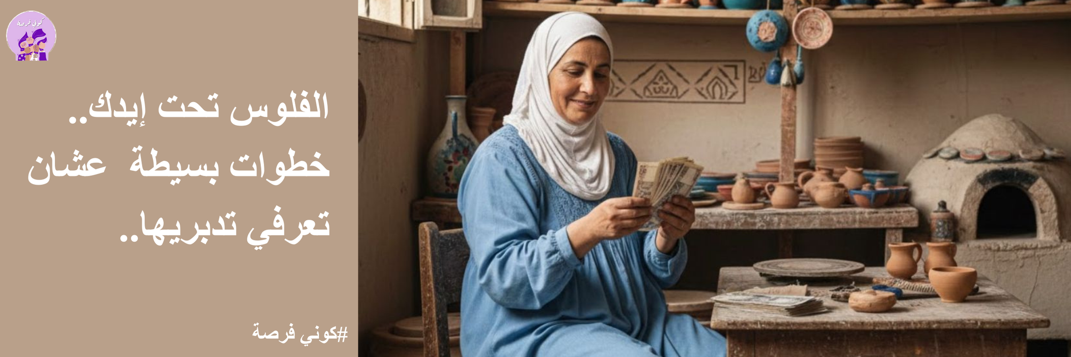
Billboards

Slide 51

Billboards

Slide 52
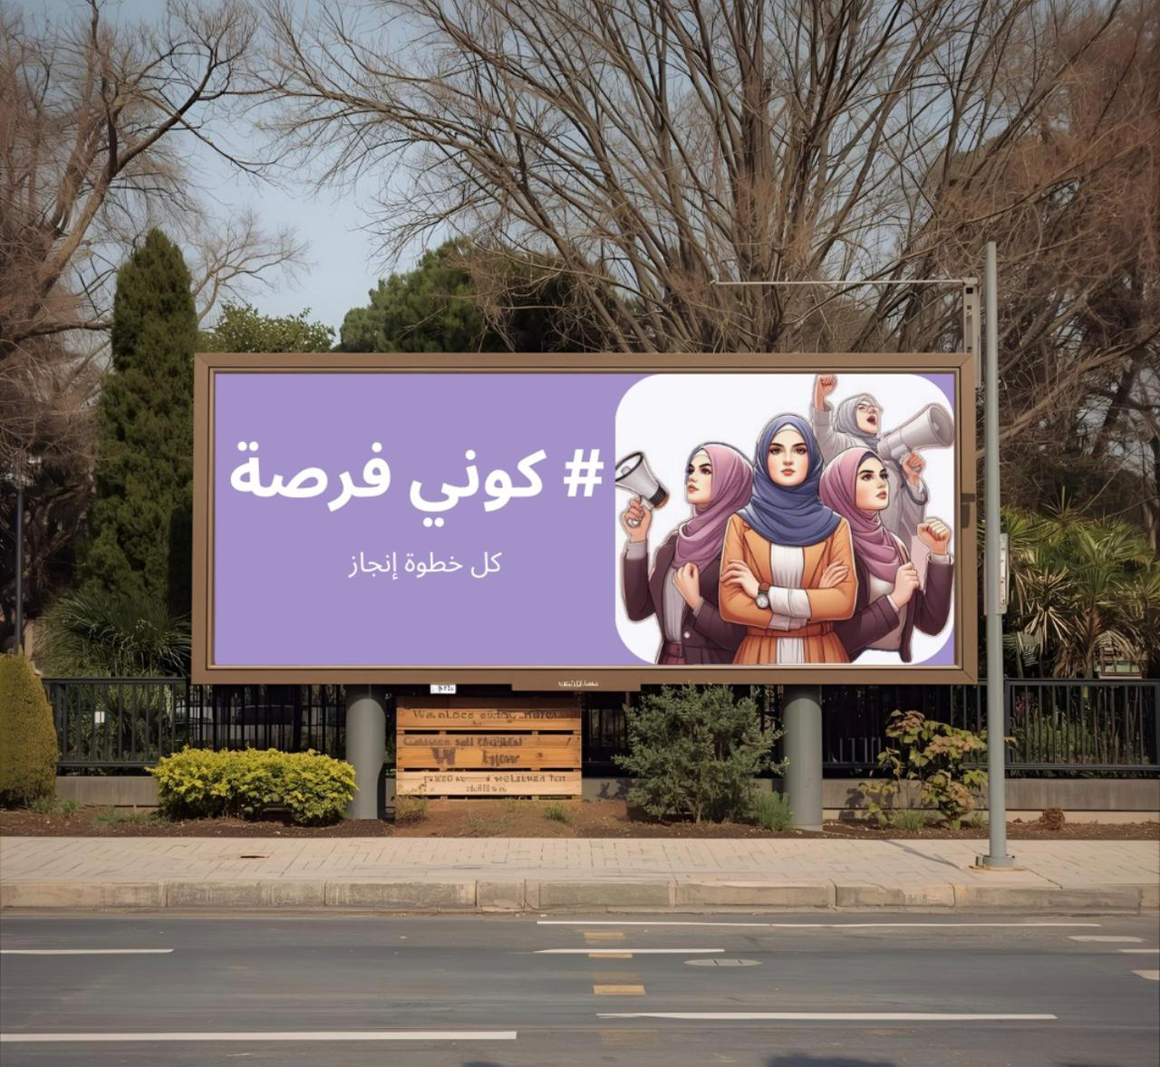
Billboards

Slide 53


Thank you!
CREDITS: This presentation template was created by Slidesgo, including icons by Flaticon and infographics & images by Freepik

