Slide 1




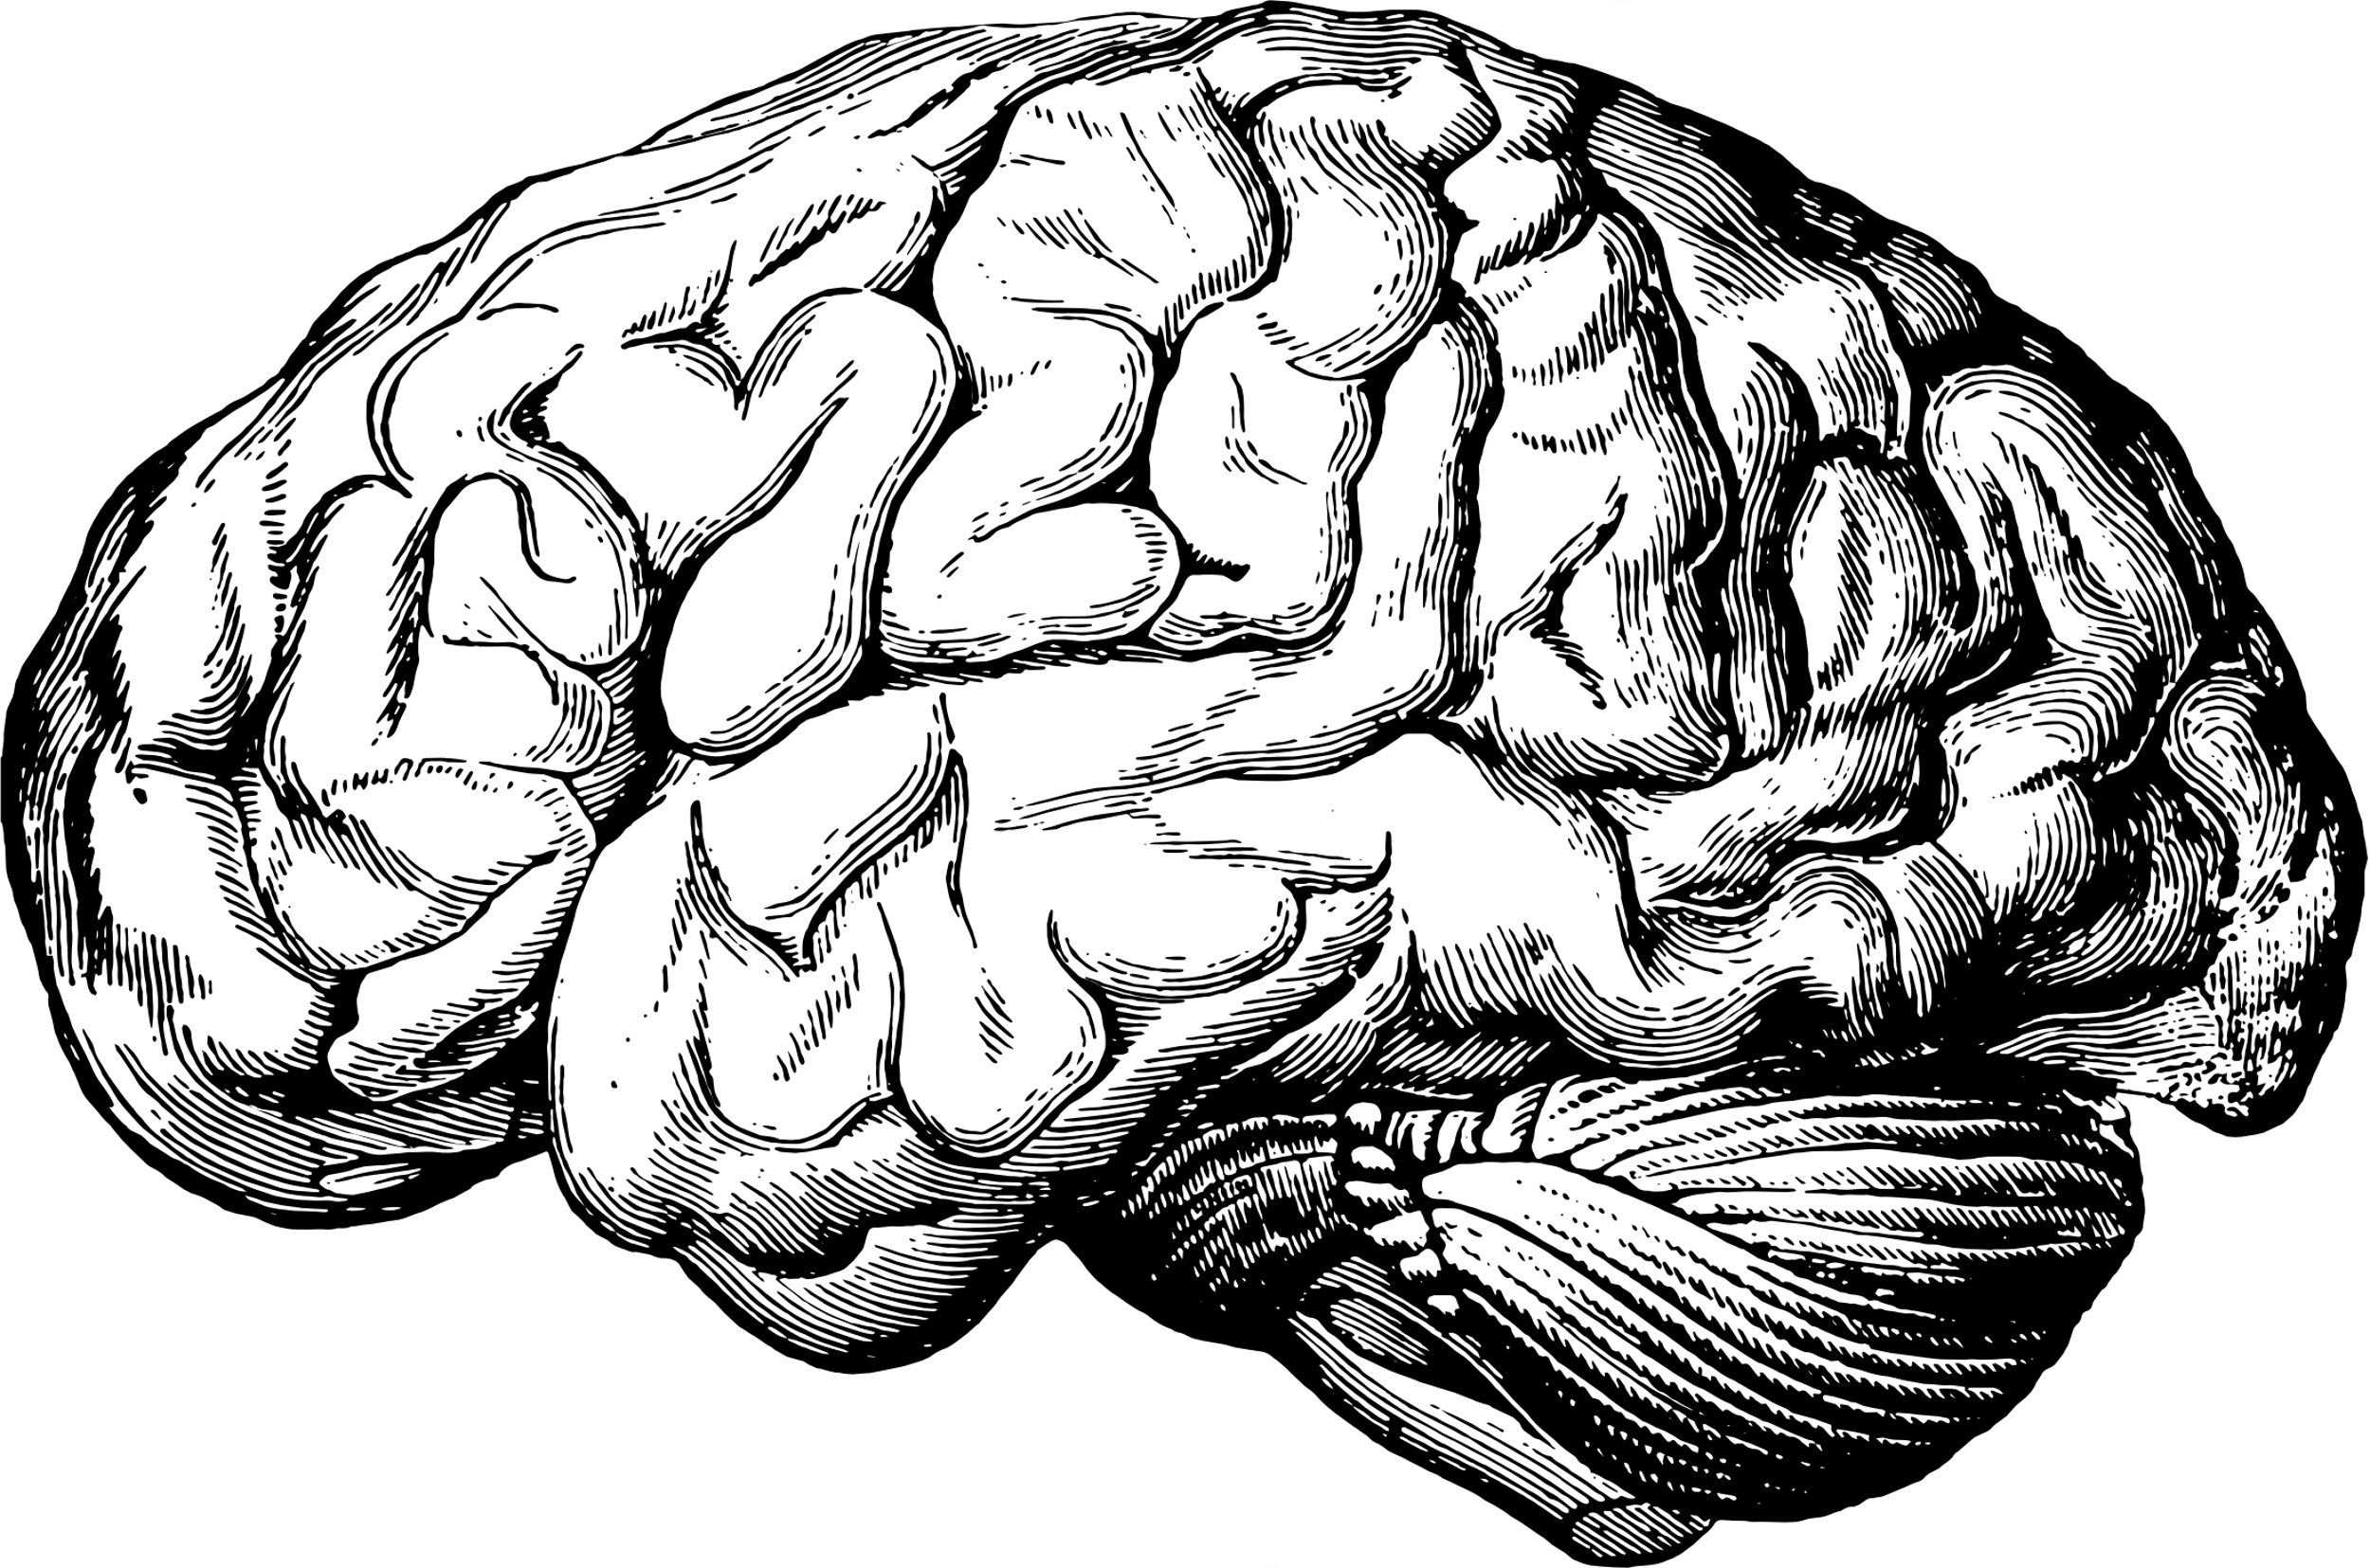







The Impact of Advertising on
Subconscious
in term: Buying behavior
Maya Mahmoud 235127
Hanin Osama 230756
Areej Mokhtar 228965

Slide 2
Table of contents
1
Introduction
6
Preliminary Audience
2
7
Marketing Mix
Objectives
3
Theory
8
Campaign slogan &message
4
Previous Campaigns
9
identify potential partners and stakeholders
5
10
Our difference
Channels of delivery

Slide 3
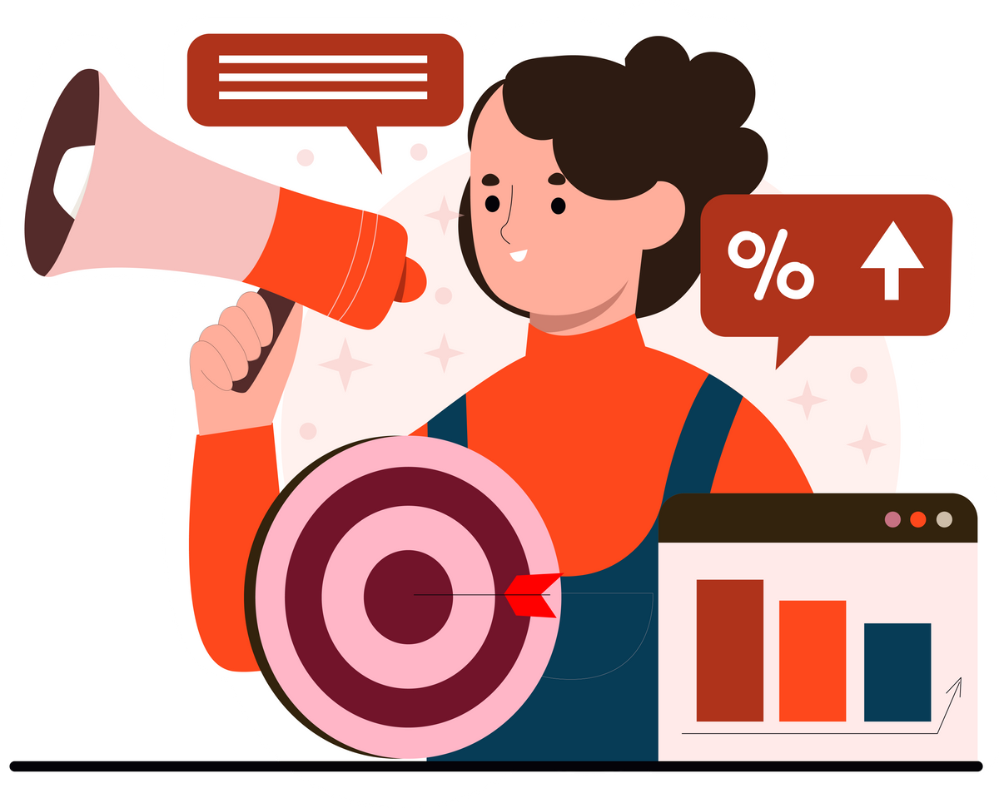
Introduction
  The Problem: Advertisers use tricks to influence our emotions and make us buy impulsively.
  Target Audience: Young adults, especially social media users, who often buy without thinking.
  Goal: Raise awareness about these hidden techniques and help people make smarter choices.
  Solution: The “Wait 24 Hours Before Buying” Challenge encourages people to pause before purchasing, reducing impulsive decisions and increasing control.

Slide 4

Objectives

Slide 5

Objectives
01
Increase young adults’ awareness by 10% about the techniques advertisers use to trick buyers through short videos shared on social media platforms within 6 weeks.
02
Encourage 30% of young adults to question an ad before making a purchase decision after being exposed to campaign content within 2 months.
Reduce 15% of impulsive buyer behavior by educating them to think about their needs before buying decisions through educated content that the campaign shares within 3 months.
03
04
Encourage 25% of young adults to participate in a campaign online challenge “ wait 24 hours before buying” within 10 weeks.

Slide 6
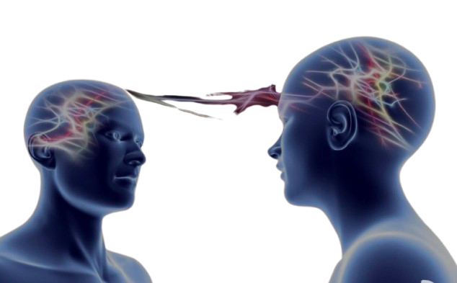
Theory related campaign

Slide 7
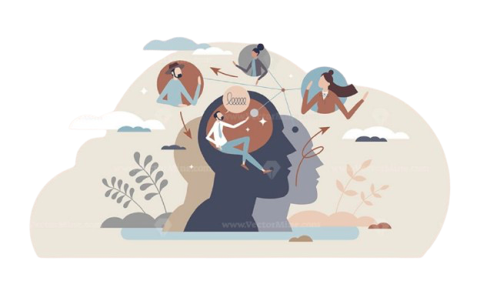
Social cognitive theory
Theory related campaign
  This theory shows that the advertisements do not show only us the product; they also affect consumers’ minds.
  When the consumer sees an ad many times , they might copy behaviors without noticing
  Ads shape the consumer lifestyle by influencing their choices or their way of purchasing.
  How ads can slowly change people’s values and social habits

Slide 8
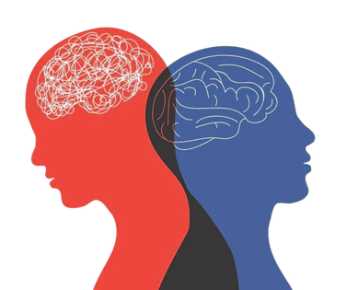
Theory planned behaviour
  Focuses on how advertisements can influence consumer attitude.
  Shows that “Self-driven” decisions is an effect of advertisements.
  Both theories are highly related, and explains the power of advertisement in connecting emotions, and beliefs subconsciously
  Subconsciously, ads can create emotional alignment with certain social values.

Slide 9
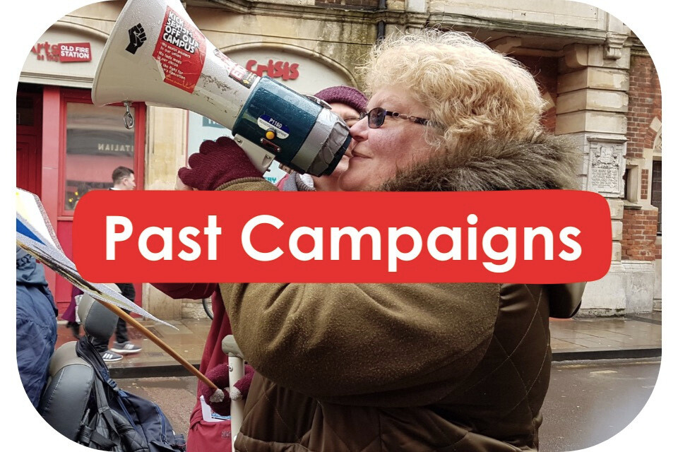
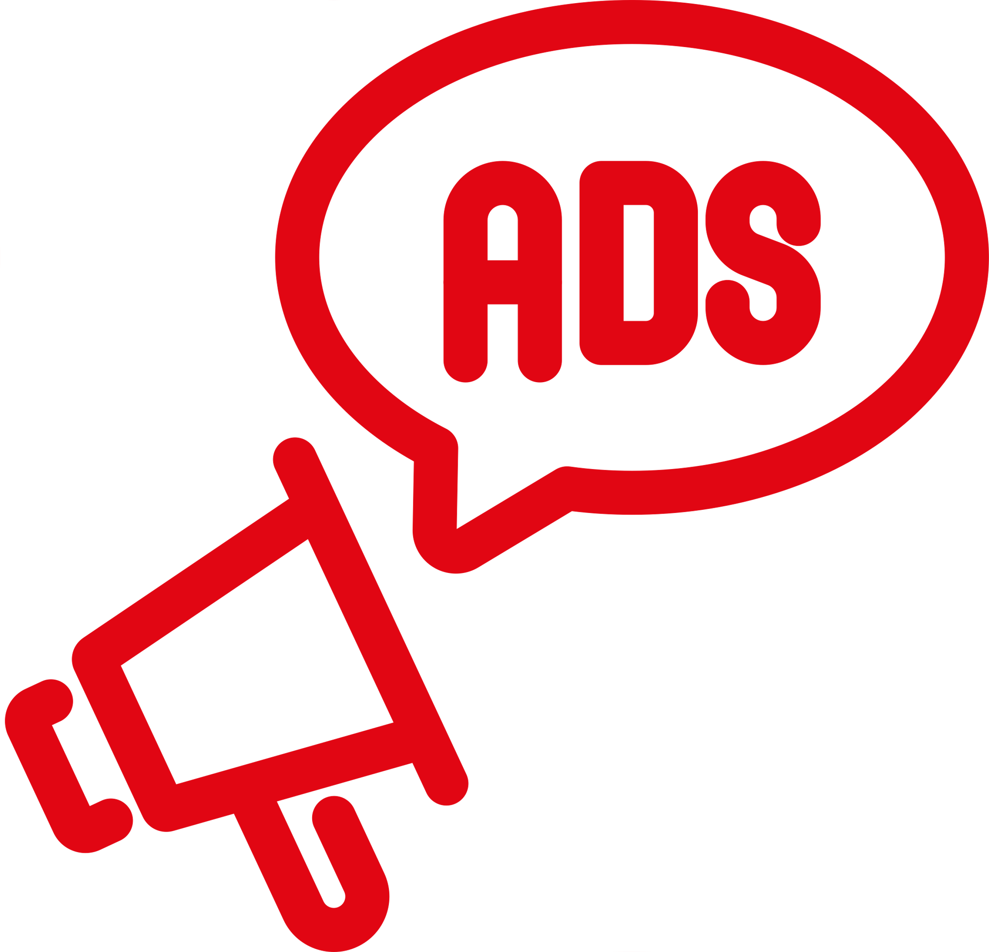
Past campaigns
about
ad influence

Slide 10

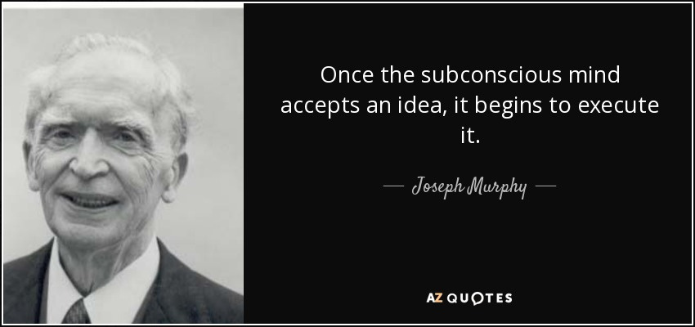
Ads impacts on behavior without people realizing it
explains that repetition of ads impacts the subconscious. Repeated ads make consumers more likely to buy or change their opinions Joseph Murphy (1963) .

Slide 11

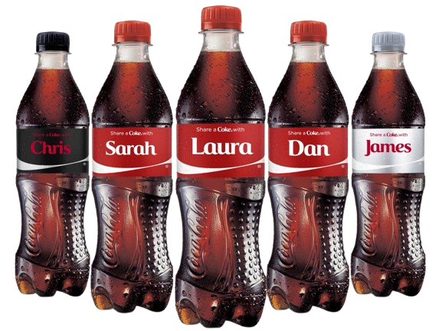
  Coca-Cola replaced its logo with people’s names, making consumers feel personally connected.
  The ad was repeated frequently across TV, billboards, and social media which impacted the subconscious strongly.
  Viewers began searching for bottles with their names and sales increased 7% in Australia and 4% in New Zealand.

Slide 12
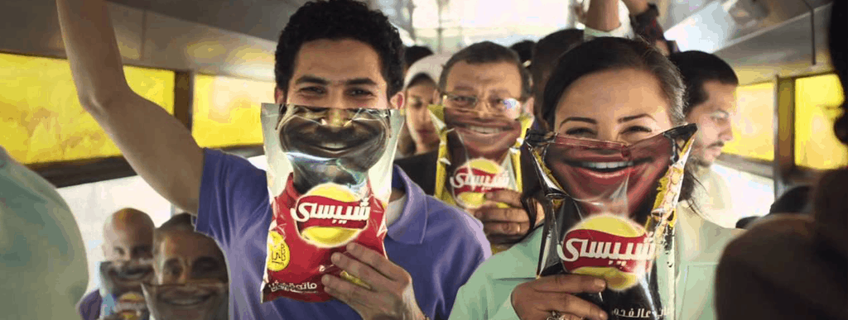
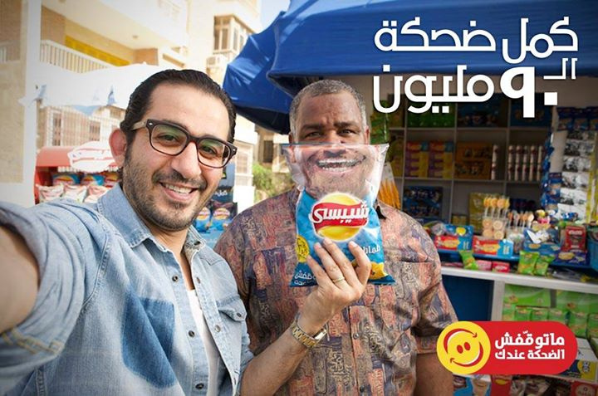
  Chipsy launched a campaign called the “Smile Campaign” in 2014.
  The company put pictures of smiling faces on the Chipsy cover.
  It also repeated the word “smile” on the cover to enhance the message.
  This made the public associate smiles and humor with Chipsy

Slide 13

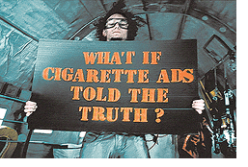
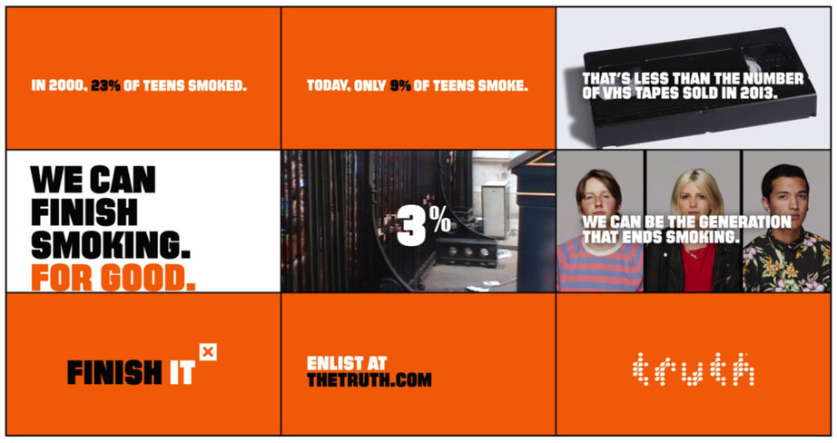
  The Truth Campaign against Smoking in the USA used repeated ads to warn against the negative impacts of smoking.
  the purpose is raising awareness about the dangers of tobacco use.
  This led to a decrease in smoking rates, especially among young people and also teenagers.

Slide 14

What is different about this campaign ?

Slide 15
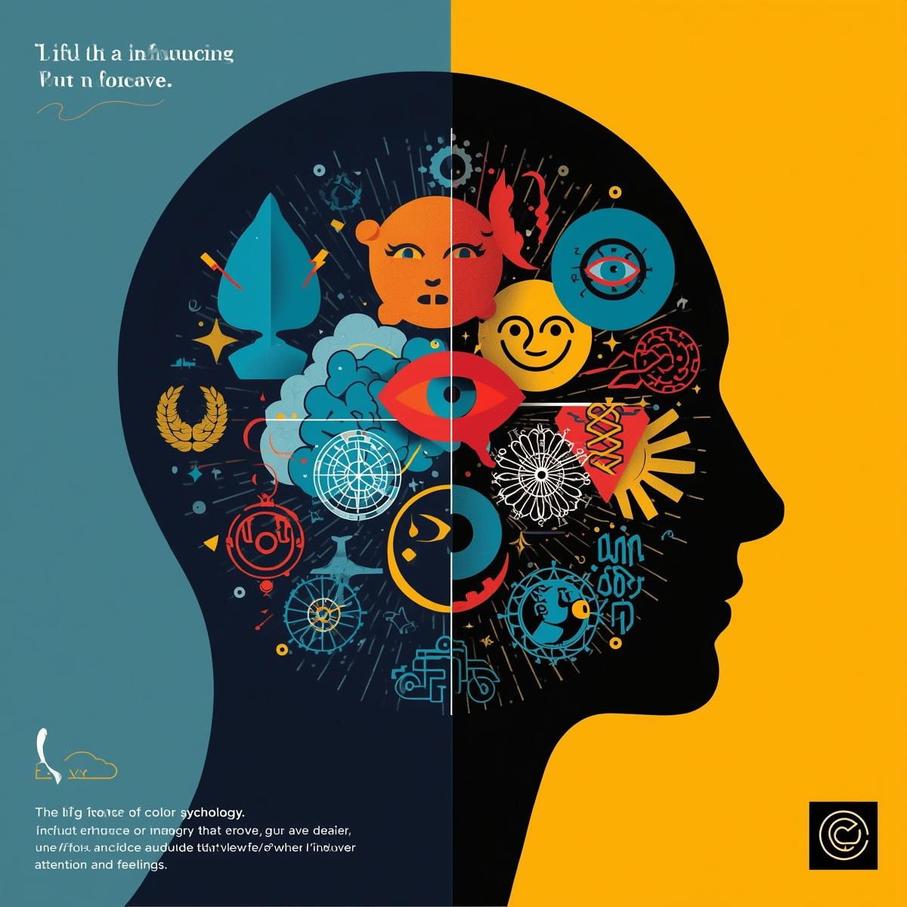
  This campaign isn’t made to sell or promote for product it’s made to raise awareness about how advertising influences our subconscious mind.
  Most ads aim to influence people. The campaign explains how that influence actually happens through repetition of ads , color, and evoked emotion.
  It makes the audiences aware to think before taking any decisions based on advertisements.

Slide 16

Preliminary Audience

Slide 17

Preliminary Audience
Segmentation
Demographic
Geographic
Psychographic
Behavioral
  Both Gender
  18-25 years old
  middle income
  Higher education
  Trendy
  Heavy social media users
  Follow influencers
  Affected by ads
  Self-learning
  Cairo
  Giza
  Alexandria
  Impulsive buyers
  Fear of missing out

Slide 18
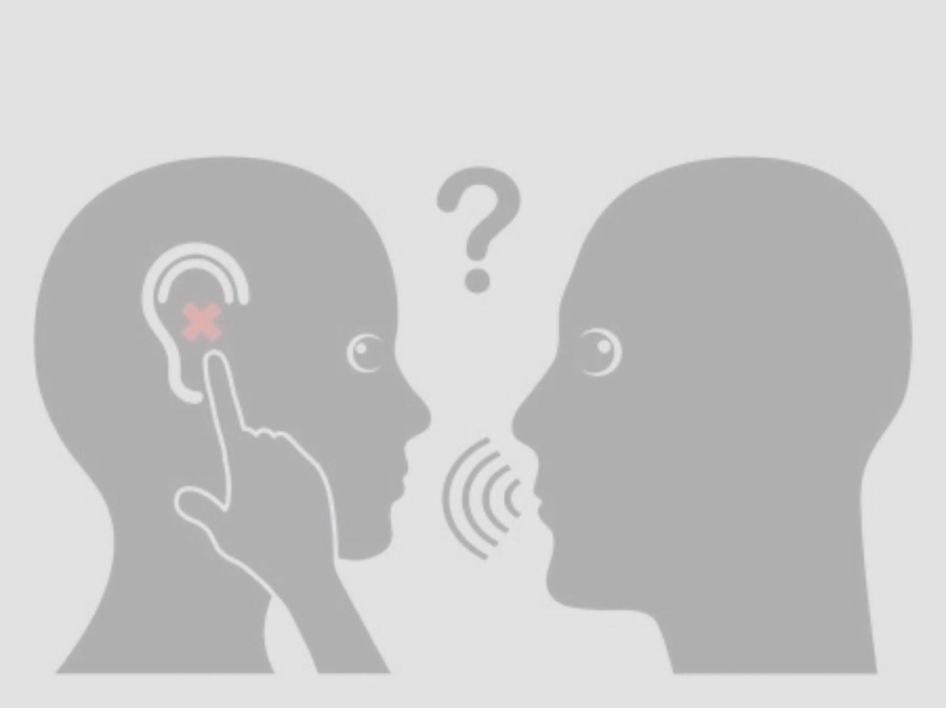
Preliminary Audience
  Advertisers use techniques to connect with buyers.
  These techniques influence the subconscious mind.
  Use storytelling, catchy visuals, and special offers to attract attention.
  Frame information to make products seem like they fit consumers’ needs even if they don’t really benefit from them.
Behavioral insights:

Slide 19
Preliminary Audience
Understanding competition:
Benefits
Barriers
  Follow trends
  Save time & effort
  Enjoy their purchases
  Fit in with society
  Take time & effort
  Miss opportunities
  Feel pressure
  Dissatisfied or left out

Slide 20


Marketing Mix
Product
Price
Place
Promotions
  Awareness
  change behavior
  Challenges
  Time
  Effort
  missing some trends
  Tiktok
  Instagram
  Facebook
  Psychologist
(Dr. Georgette Savvides)
  Influencer
(Sarah Hany)
Marketing Strategy

Slide 21




Slide 22
Slogan and campagin message
Slogans:
Messages:
  فكر فيها قبل ما تشتريها.
  كل مايتكرر كل ما تتأثر
  انت التتحكم في اختيراتك مش الاعلانات
  الإعلانات مش بتركز عليك بتركز علي عقلك .
  الإعلانات بتتكرر طريقتك تتغير
  الإعلانات بتسيطر علي تفكيرك و انت بتسيطر علي نفسك

Slide 23
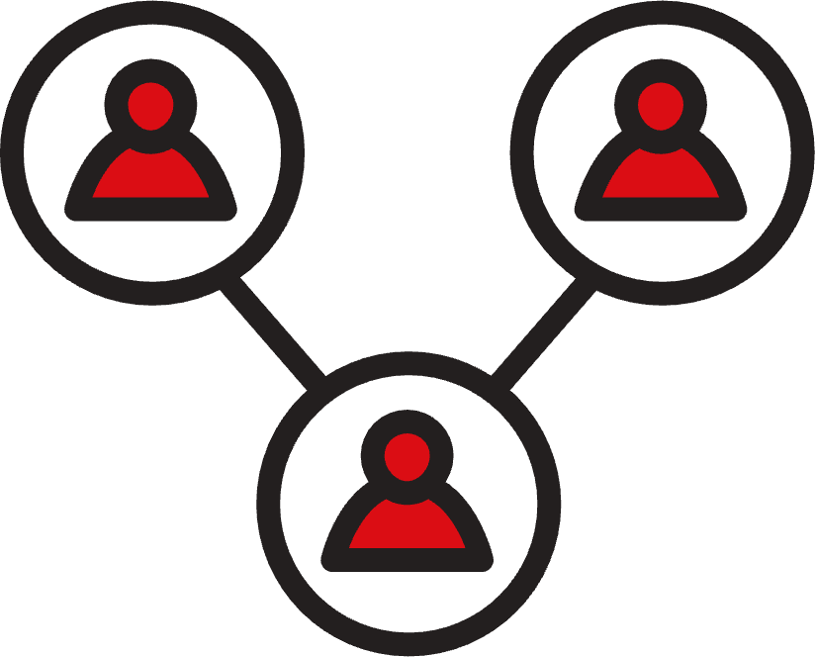
POTENTIAL PARTNERS
AND STAKEHOLDERS

Slide 24
  Ministry of youth and sports
  Ministry of communication
  Universities (psychology departments)
  Media platforms ( instagram , Tikok and Facebook)
  Brands and advertisers
  telecom companies (Vodafone, Etisalat)
  Media outlets (El Youm 7, Cairo Scene, and masrawy)
  Tech companies (Apple and SamSung)
Low power-High interest
High power- High interest
  Youth and consumers
  social media users
  Parents
  psychologist and media educators
High power- Low interest

Slide 25


Partnerships

Slide 26

Channels of delivery

Slide 27
  The campaign will use multiple channels to reach its target audience and communicate its message effectively.
  The main platforms used are Instagram,TikTok, and Facebook, as they are popular among the target audience.

Slide 28
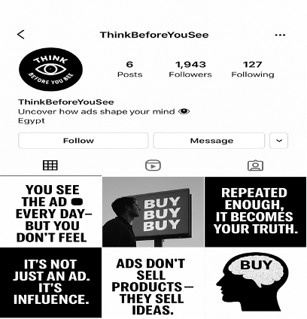
  Instagram will focus on visual designs and simple photos instead of short videos or reels , delivering messages like “Stop repeating; it will be your reality.”
  This supports reflection so that the audience remembers the message when they see similar ads again.
  Instagram will act as the campaign’s visual platform, encouraging users to share their experiences with repetitive advertising through comments and will reply to them.

Slide 29
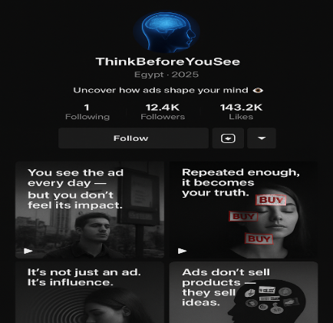
  TikTok will focus on short videos and interactive videos explaining how repetitive advertising affects the subconscious mind, using examples ads .”
  These videos will help to explain how repetition shapes consumer behaviors and beliefs .
  TikTok will also support users to join and share their personal experiences, helping the campaign spread faster.

Slide 30
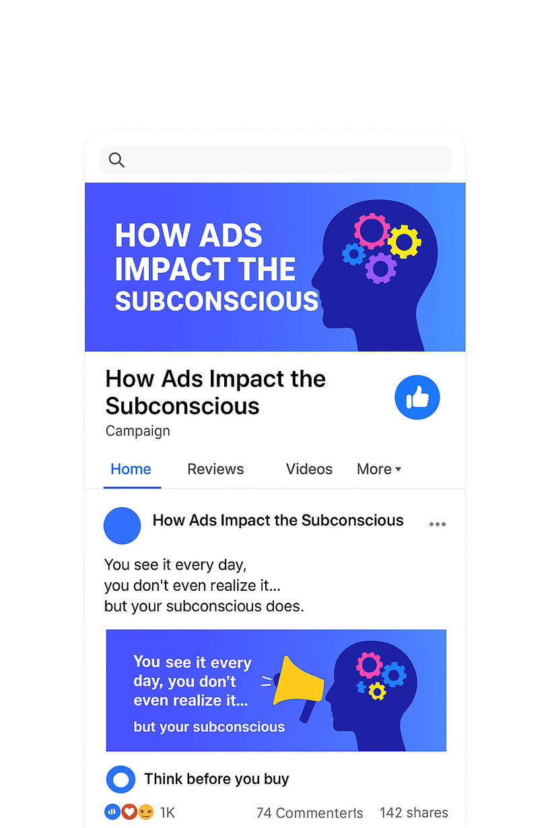
  Facebook will combine posts, videos, and clips from other platforms to provide a deeper understanding of the campaign.
  Facebook will create groups and pages that will create a space for discussing how advertising repetition influences the subconscious mind.

Slide 31
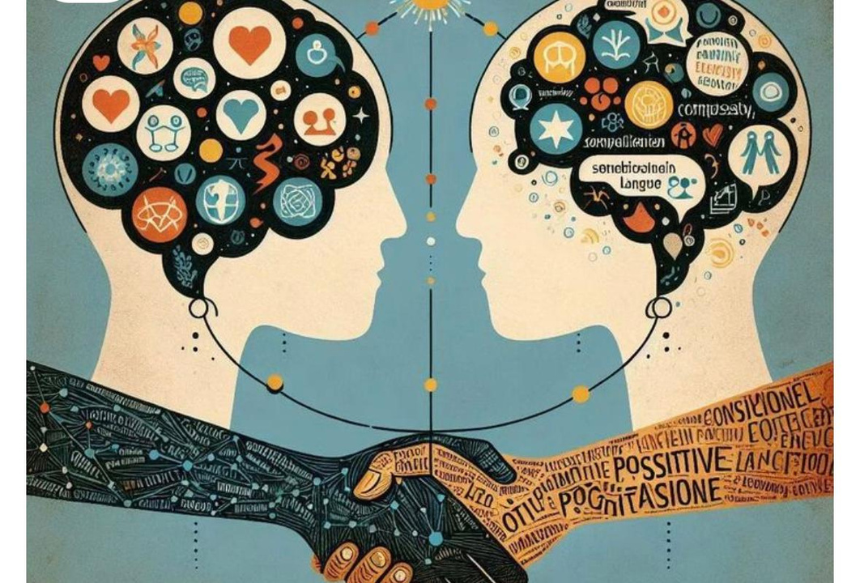
Ethical Analysis

Slide 32

Ethical Analysis
Equity
  Make sure the campaign is reachable to all audiences.
  Reach youth in different places such as cities and rural areas
  Use the platform that everyone can access
  Providing subtitles for people who struggles with hearing the problems

Slide 33
Cultural sensitivity
  present the subconscious influence in a positive way not in a negative way
  explaning that advertisments does not control the mind but it influences the mind
  use content that aligns with Egyptian culture. and avoid anything that is offensive and inappropriate
  use simple and respectful language

Slide 34
Un-intended effect
  Some viewers may feel stressed about subconscious
  The message might be misunderstood
  Too many warnings can make people afraid and stressed

Slide 35
How we prevent this
  Test the campaign content with a small group before publishing the campaign
  Review content with media educators and psychologists.
  Improve any content that may cause misunderstanding or negative effect

Slide 39



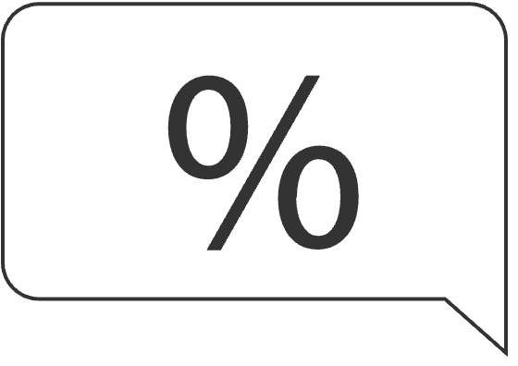




Thanks!
%

